Slide 1
Balanced and Unbalanced
Key words
balanced
equilibrium
unbalanced
driving force
resistive force

Slide 2
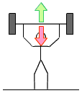
How to draw force diagram
Use a ruler and pencil
The size of arrow shows the size of the force.
The direction of the arrow shows the direction of the force.

Slide 3
Balanced Forces
When two forces acting on an object are equal in size but act in opposite directions, we say that they are balanced forces.
If the forces on an object are balanced (or if there are no forces acting on it) this is what happens:
an object that is not moving stays still
an object that is moving continues to move at the
same speed and in the same direction

Slide 4
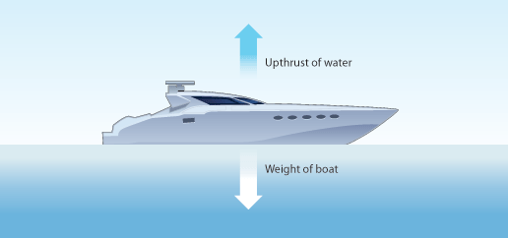
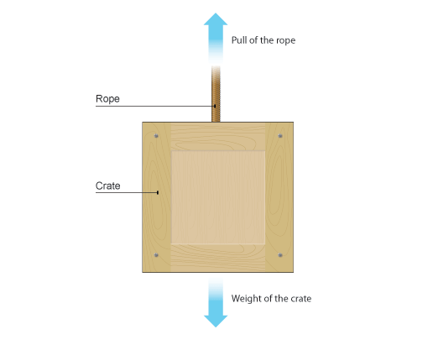
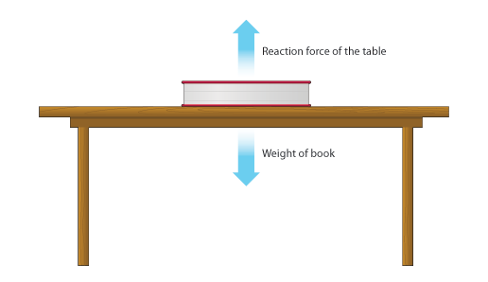
Balanced Forces

Slide 5
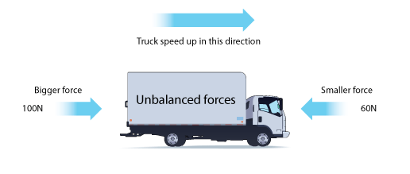
Unbalanced Forces
When two forces acting on an object are not equal in size, we say that they are unbalanced forces.
an object that is not moving starts to move
an object that is moving changes speed or direction

Slide 6
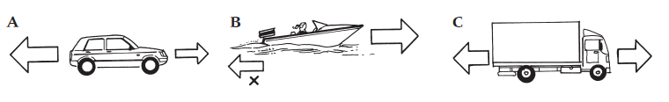
To Do
Is this a balanced or unbalanced force?
Which way is it moving or is it standing still?
Is this a balanced or unbalanced force?
Which way is it moving or is it standing still?
Is this a balanced or unbalanced force?
Which way is it moving or is it standing still?

Slide 7
Resultant Forces
The size of the overall force acting on an object is called the resultant force.
If the forces are balanced, this is zero. In the example above, the resultant force is the difference between the two forces, which is 100 - 60 = 40 N.

Slide 8
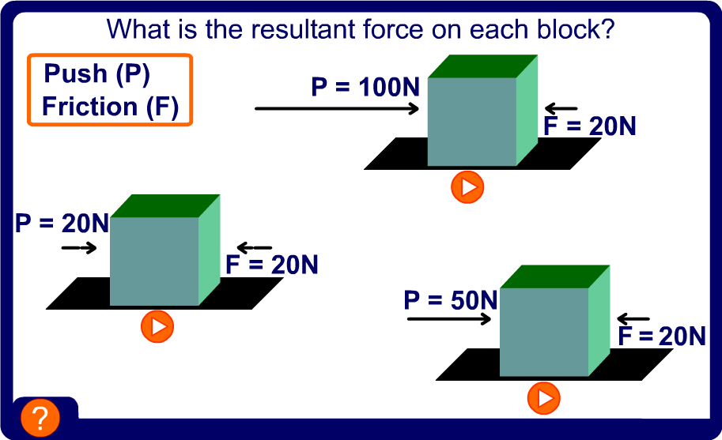
Resultant Forces
Copy these into your book and work out the resultant forces. Say which way the block will move and with how much force.

Slide 9
Balanced and Unbalanced
Sort the following statements into whether the forces involved are balanced or unbalanced.
The ball speeds up as it falls to the ground.
The ball starts to move when it is kicked.
The ball stays still after it lands.
A football stays still on the ground.
The ball slows down as it goes higher.

Slide 10
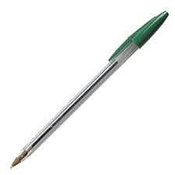
P1.5 Balanced and Unbalanced
Balanced | Unbalanced
The ball stays still after it lands | The ball speeds up as it falls to the ground.
A football stays still on the ground. | The ball starts to move when it is kicked
 | The ball slows down as it goes higher.

Slide 11
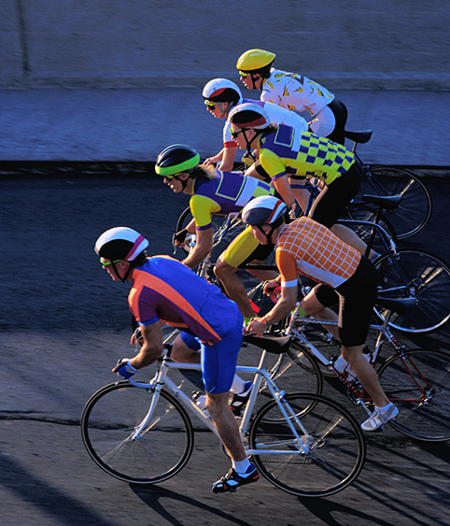
Balanced and Unbalanced
A cyclist is slowing down as she is cycling along a road.
Draw a diagram to show the forces acting on the cyclist (1 mark)
Label the forces using the words “resistive” and “driving” (1 mark)
Explain why her speed is decreasing. (1 mark)

Slide 12
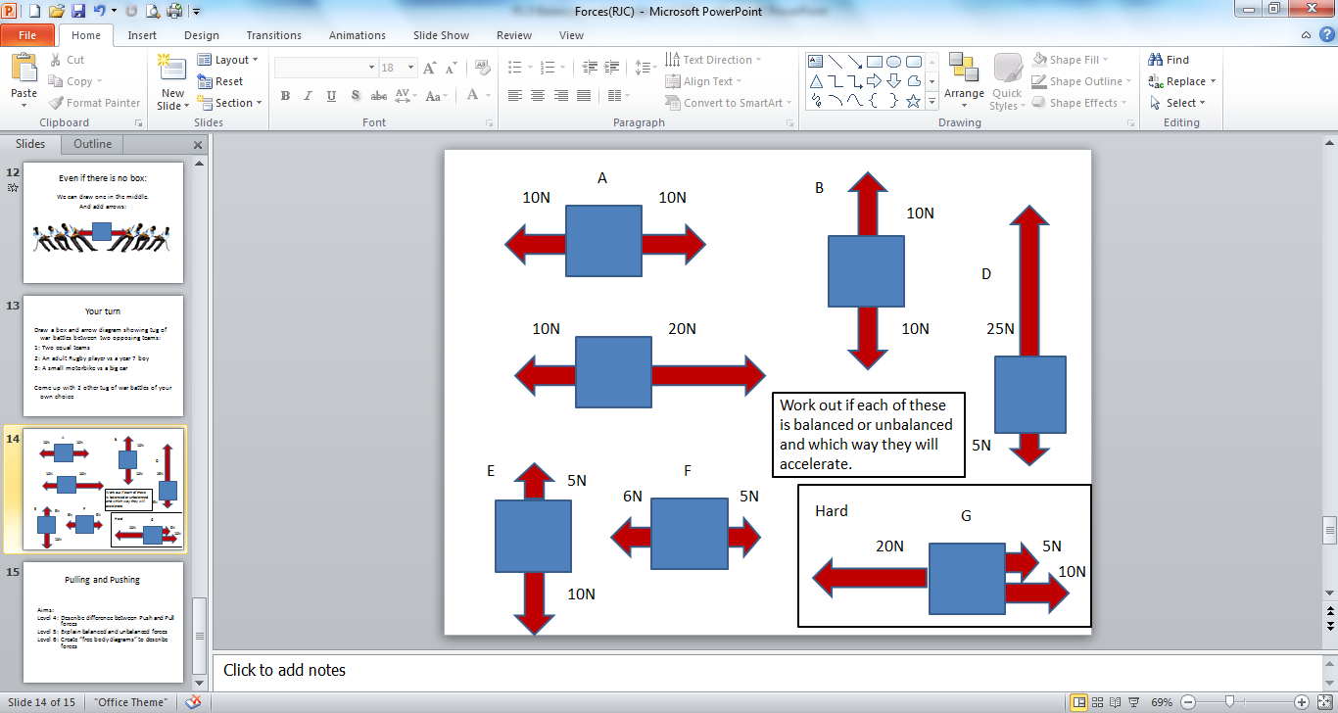
P1.5 Balanced and Unbalanced
A cyclist is slowing down as she is cycling along a road.
Draw a diagram to show the forces acting on the cyclist (1 mark)
Force diagram with an arrow showing that the resistive force is bigger than the driving force eg.
b) Label the forces using the words “resistive” and “driving” (1 mark) Driving Resistive
c)Explain why her speed is decreasing. (1 mark)
The forces are unbalanced

Slide 13
Plenary
List different situations at home where forces are balanced or unbalanced.
Name the forces involved.
Identify the direction and relative size of the forces.

